Slide 1

2048 Game Project Presentation
Submitted by-
Sachin Chouhan
Sachin Jat
Rounak Chouksey
Submitted To-
Mrs. Nisha Rathi

Slide 2
2048 Game

Slide 3
Introduction- This 2048 Game is based on a concept of colliding the same two numbers to create a new number with the total sum of the two numbers. This whole system is in C++ language. This game is a single player interesting game. It is played on a 4×4 grid, with numbers that slide smoothly when a player moves them using the four arrow keys. Every turn, a new number will randomly appear in an empty spot on the board with a value of either 2 or 4. It is very effective and simple understanding for beginners.

Slide 4
About The Project-
2048 Game project is designed in ‘C++’ language. This system is based on a concept to move numbers on a grid to merge them to form the number 2048. However, you can keep on playing the game by creating larger numbers. In each move, a new number of displays (2 or 4). The player has to move the numbers using arrow keys and try to collide the same two numbers which create a new number with the total sum of the two numbers. Numbers slide as far as possible in the chosen direction until they strike on either another number or the edge of the grid. Also,this project is easy to operate and understood by the users.

Slide 5
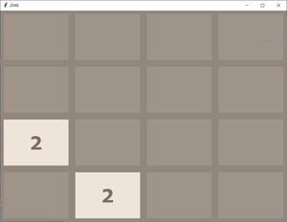
How to play 2048
1. There is a 4*4 grid which can be filled with any number. Initially two
random cells are filled with 2 in it. Rest cells are empty.

Slide 6
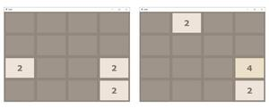
2. we have to press any one of four keys to move up, down, left, or right.
When we press any key, the elements of the cell move in that direction
such that if any two identical numbers are contained in that particular row
(in case of moving left or right) or column (in case of moving up and down)
they get add up and extreme cell in that direction fill itself with that
number and rest cells goes empty again.

Slide 7
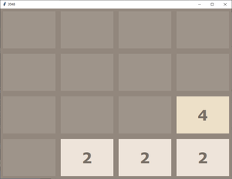
3. After this grid compression any random empty cell gets itself filled with 2.

Slide 8
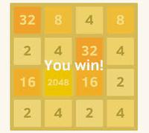
4. Following the above process we have to double the elements by adding
up and make 2048 in any of the cell. If we are able to do that we wins.🎊🎊

Slide 9
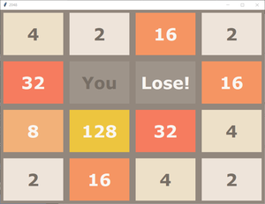
5. But if during the game there is no empty cell left to be filled with a new 2,
then the game goes over.😥😥😥😥

Slide 10
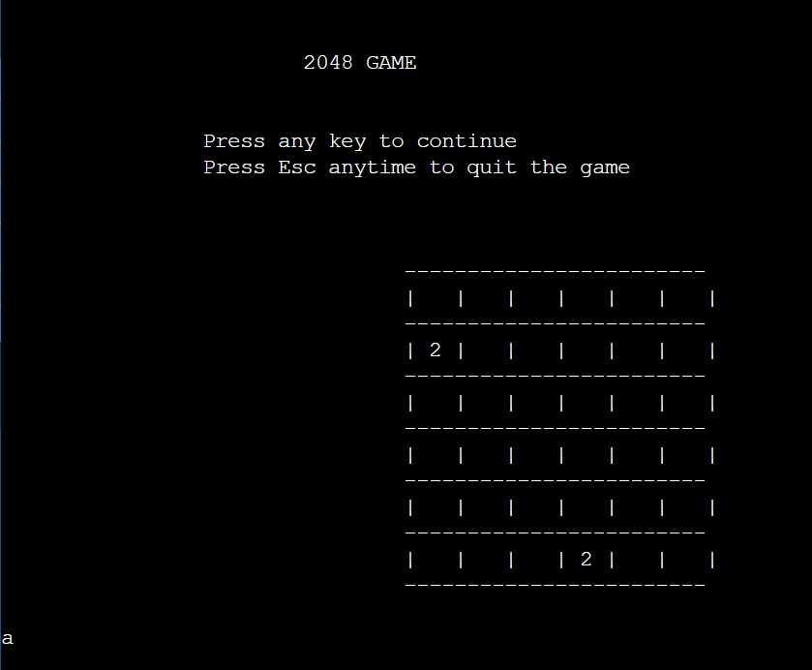
Example :

Slide 11
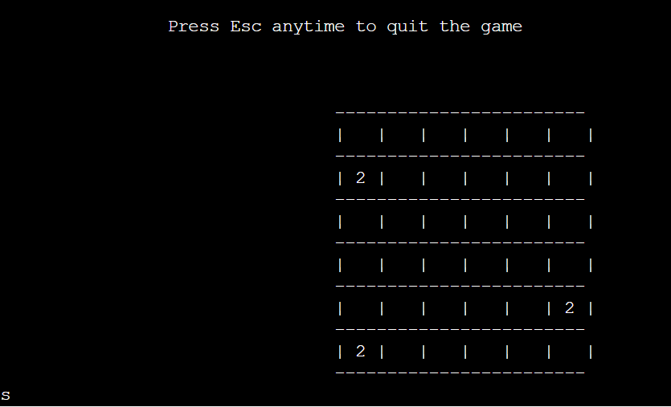

Slide 12
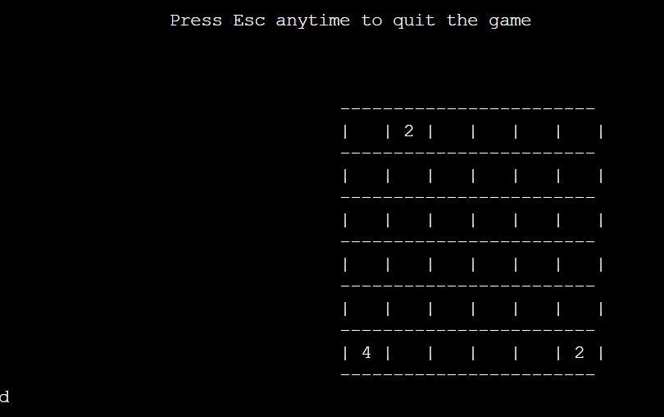

Slide 13
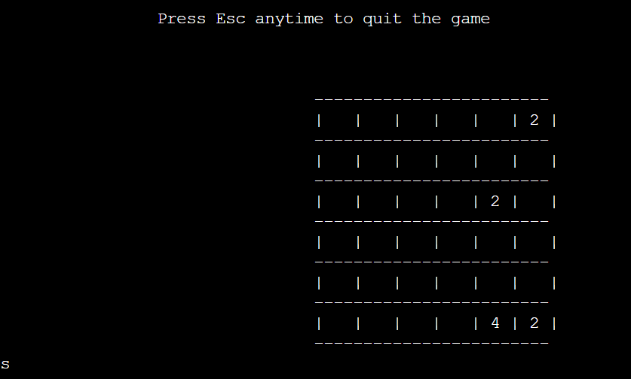
AND SO on……… And the series of input output will go on till we lose or win!

Slide 14
Features:
up arrow (w) – to move upward
down arrow (s) – to move downward
left arrow (a) – to slide the numbers to the left
right arrow (d) – to slide the numbers to the right
Exit (x) – to exit the game

Slide 15
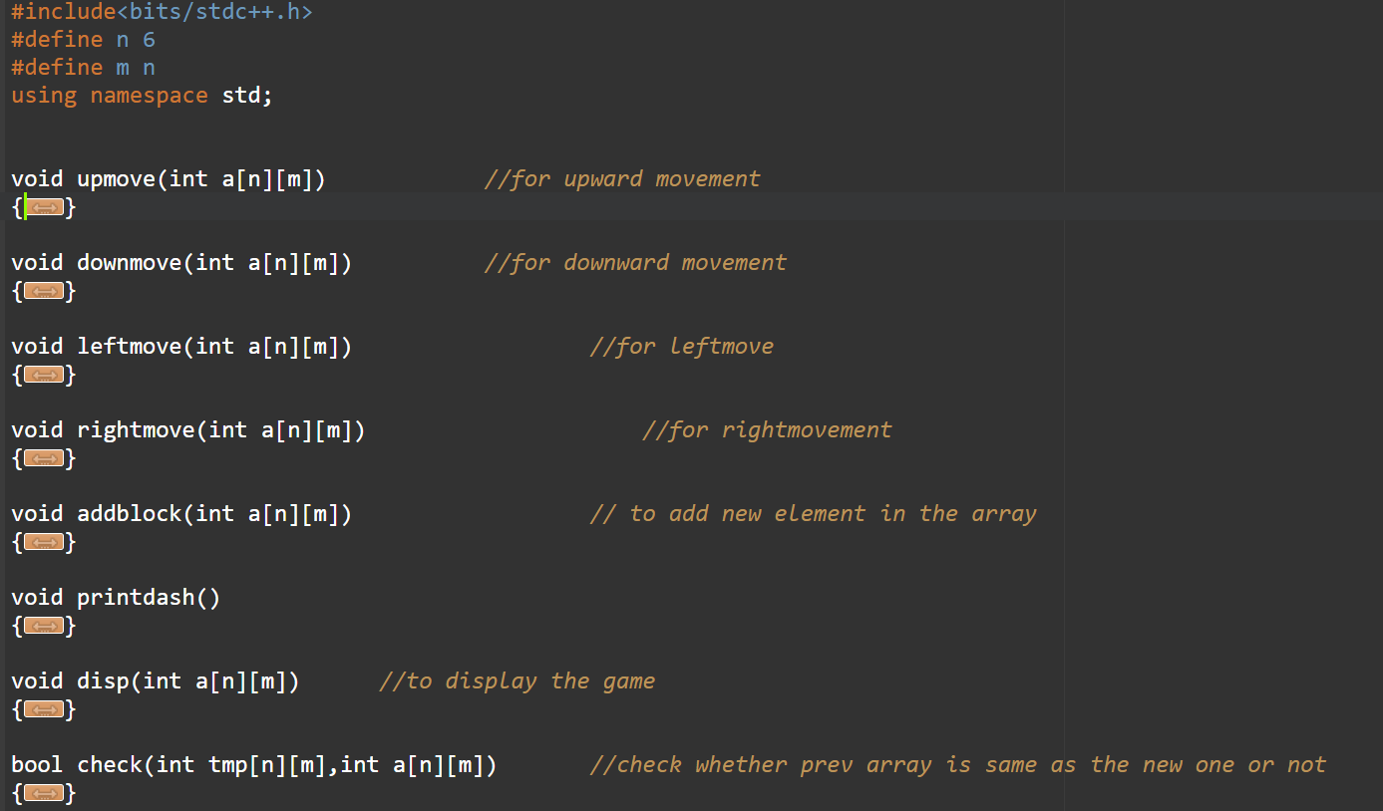
Some Screenshots

Slide 16
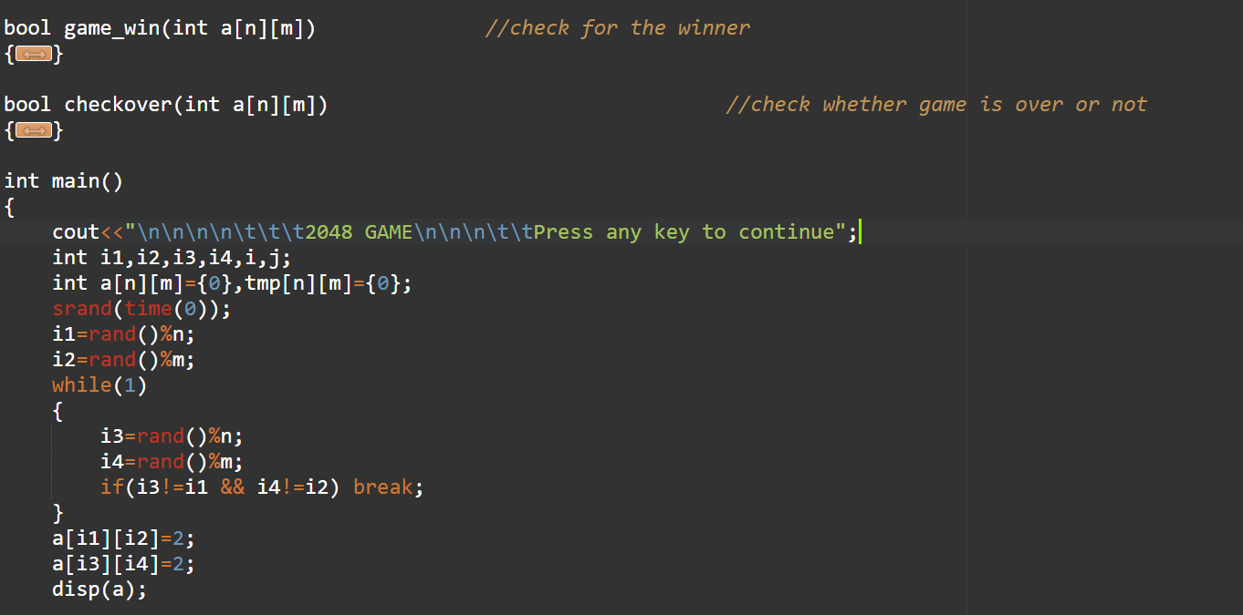

Slide 17
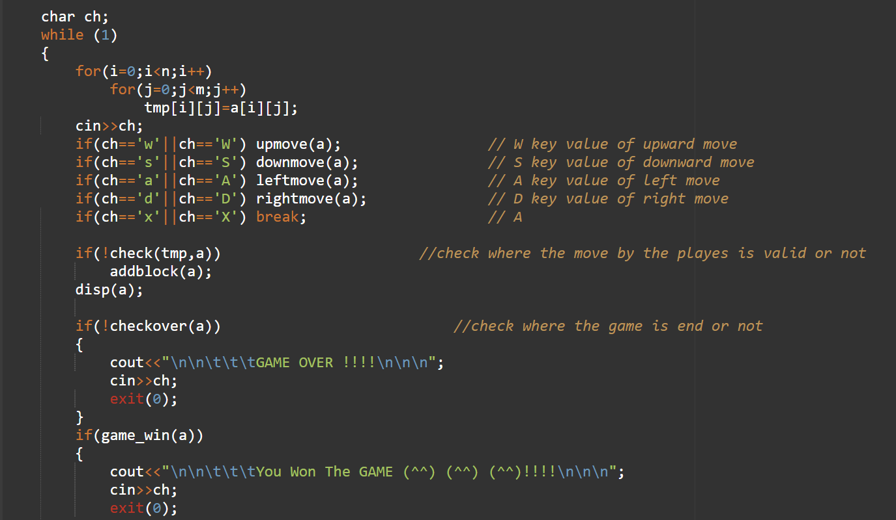

Slide 18


